Slide 1
Local Food and AI
June 12, 2023
Mohammad Ahnaf Sadat
PhD Student, IMSE

Slide 2
Project Goal is described from two perspectives
Farmer:
a decision-making tool for where to sell products at the farmer’s set price point and current production scale.
Researcher:
a tool to analyze trends across different products based off various indicators such as fresh vs. processed, diversification of market outlets, variations in production scale.

Slide 3
Project Summary and the inherent questions
Provide localized and up-to-date demand forecasting information to make better informed decisions including
setting price-points
crop planning
value-added processing
What to grow?
Where to grow?
How much to grow?
Where to sell?
How to sell (processed/not processed)? [This question is not addressed in this document]
Notes:
Encompasses
In summary

Slide 4
Project Flowchart showing possible modules
Yield prediction for each crop/food items at each location
Demand forecast for each crop/food items at each location
Crop allocation
(where/when to plant crops) for each farmer and each crop/food items
Supply chain optimization (where to sell) for each farmer and each crop/food items
Notes:
divided

Slide 5
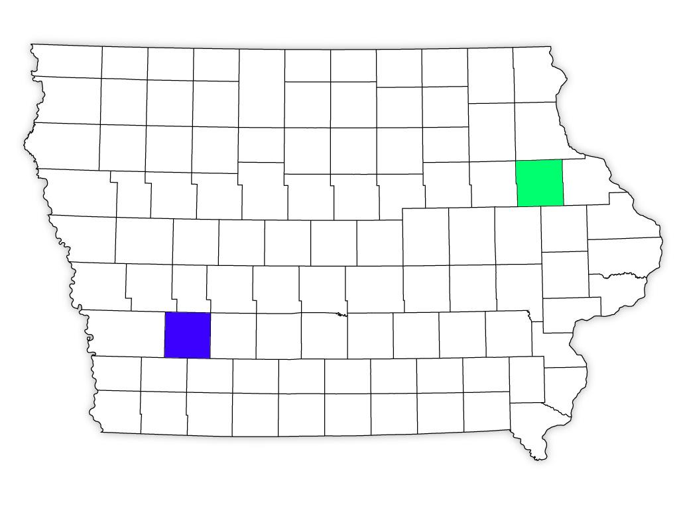
Yield Prediction (A illustrative output from the module is shown)
This module is a necessary step to answer, “What to grow and where to grow?”
Crop | Predicted yield (metric ton/hectare)
Tomato | 60
Corn | 8
Soybean | 2
Crop | Predicted yield (metric ton/hectare)
Tomato | 50
Corn | 10
Soybean | 2.5
Notes:
Necessary step to answer what to grow and where to grow

Slide 6
Yield Prediction
Goal: To determine the crop/food item yield per unit area for a specific location in small farms.
Challenges:
Predicting the yield of each different crop/food item would be different. For example, predicting the yield for heirloom tomatoes would be substantially different from that of corn.
Furthermore, the factors affecting the yield of heirloom tomatoes would be different from that of eggs/bacon.
The lack of data poses a significant challenge for specific crops or food items.

Slide 7
Yield Prediction
Potential/temporary solution:
We can use the data of a closely related crop as a proxy. For example, in the absence of heirloom tomato data, we can rely on the data from closely related varieties like roma tomatoes as a substitute.
A thorough literature review is necessary to identify potential proxy crops for our target crops.
Current tasks:
Finding out the data, if possible.
In the absence of data, we will determine a suitable proxy crop to serve as a substitute for the crop of interest.

Slide 8
Demand Forecasting (A illustrative output from the module is shown)
This module is a necessary step to answer, “What to grow, where to grow, how much to grow, where to sell?”
Crop | Demand (metric ton)
Tomato | 100,000
Corn | 1,000,000
Soybean | 36
Crop | Demand (metric ton)
Tomato | 50,000
Corn | 1,360,000
Soybean | 30

Slide 9
Demand Forecasting
Goal: To forecast the demand for a crop/food item at a given location.
Challenges:
Demand data for certain crops/food items might not be available.
Determine the factors that influence the demand.
Finding out the data of these factors

Slide 10
Demand Forecasting
Potential and temporary solution:
If data regarding the key factors and/or the historical demand data of crop/food items are not available, we can build an economic model based on the following concepts:
the relation between a product's supply, demand with price (in this case, crop/food item) as described in economics!
factors affecting the demand and supply of the product.
factors affecting demand and supply of the complimentary products.
factors affecting the demand and supply of substitute products.
Current tasks:
Finding out the historical pricing data at different locations.
Finding out the demand data at different locations.
In situations where data is unavailable, we can opt to develop an economic model instead of relying on a data-driven approach.

Slide 11
Crop Allocation (A illustrative input for the module is shown)
This module answers “Where to grow, what to grow, how much to grow?”
Crop | Demand (metric ton) | Predicted yield (metric ton/hectare)
Tomato | 100,000 | 60
Corn | 1,000,000 | 8
Soybean | 36 | 2
Crop | Demand (metric ton) | Predicted yield (metric ton/hectare)
Tomato | 50,000 | 50
Corn | 1,360,000 | 10
Soybean | 30 | 2.5

Slide 12
Crop Allocation (A illustrative output from the module is shown)
Where to grow, what to grow, how much to grow
Tomato, Soyabean
Corn

Slide 13
Crop Allocation
Goal: To determine the most favorable combination of crop types, planting locations, and quantities for individual farmers.
The objective is to enable farmers to make informed decisions regarding their crop selection, where to plant them, and how much to produce, ultimately maximizing the overall profitability across all farmers involved.
Challenges: A common error is advising all farmers to focus on cultivating a single crop that has the potential for high revenue. Such situations can lead to a significant increase in the supply of that specific product, causing a shortage of supply for other crop/food items.
Current task: A toy model demonstrating the concept.

Slide 14
Crop Allocation
Feedback received:
We should consider farmers' willingness to accept our recommendation.
We should not enforce hard boundaries for planting crops, such as restricting a county to grow only corn and excluding other crops. Instead, we should adopt a flexible approach that allows for the cultivation of various crops in every county.

Slide 15
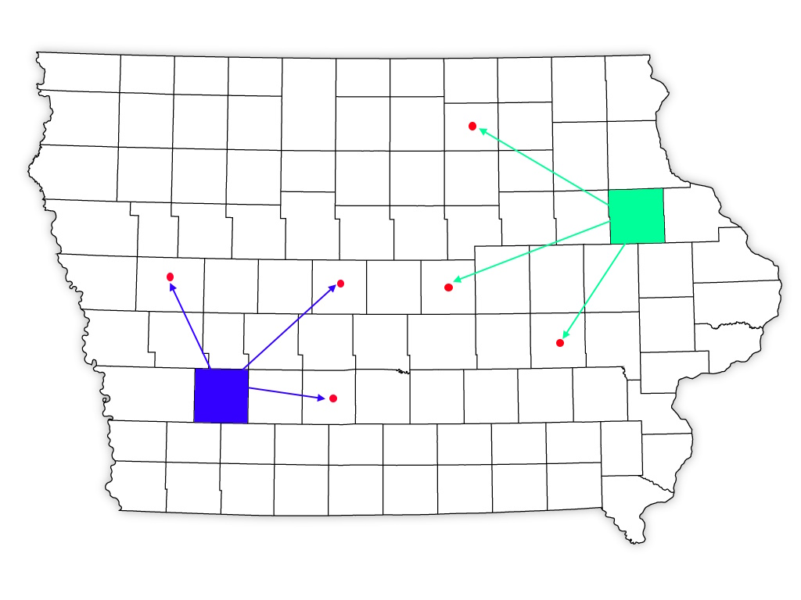
Supply Chain Optimization (A illustrative output from the module is shown)
This module answers “Where to sell?”
Notes:
The final module

Slide 16
Supply Chain Optimization
Goal: To determine where and at what quantity a farmer should sell crops/food items, maximizing the overall profit among all the farmers.
Challenges:
The yield of the crops would be distributed in the final phase of the crop cultivation months.
Depending on the freshness and amount of the crops to sell, the decision support system (our software) should recommend the store for selling the products.
Current task: A toy model demonstrating the concept.

Slide 17
Supply Chain Optimization
Feedback received:
A map of the demands and the supplies of the crops itself provides hints about where to grow and sell products.

Slide 18
Thank you!

